Slide 1


Cable One: Customer Churn Analysis
Team 1: Mid Semester Update
Team : Sreevatsan Agoramurthy, Marlee Coolidge, Yi-Wun (Wendy) Chen, Mohammad Aramimehr

Slide 2
Objective
Analyze datasets to find possible causes of customer attrition and recommend solutions to the team

Slide 3
Information available
Demographical information
Product information
Product usage information
Service orders information

Slide 4
Approach
Data cleaning – preprocessing data to make it useful to work with
Exploring each dataset
Plotting key infographics – revealing possible causes of defection
Time series forecasting – predict when a customer is likely to leave
Final report on Findings

Slide 5
Progress so far
Preprocessed the four datasets
Performed Exploratory Data Analysis on the datasets-
Demographics
Product
Usage
Orders

Slide 6
Exploratory Data Analysis

Slide 7
Demographics
Contains key information on customer’s
Geographical location
Lifetime Value
Subscriberwise score
Clusters defined by ConneXions
Account information
Customer Status – Active/Disconnected
Number of customers identified = 252573 unique customers

Slide 8
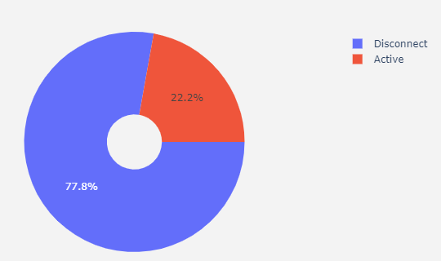
Representation of attrition in data
196503
56070

Slide 9
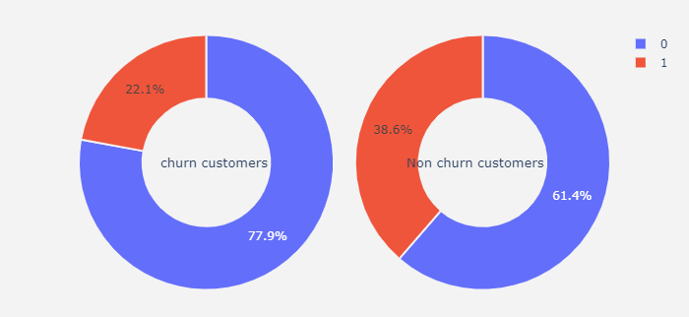
Deposit Account information by customer status
Has no deposit account
Has deposit account
Inference : Customers that leave are less likely to have a deposit account

Slide 10
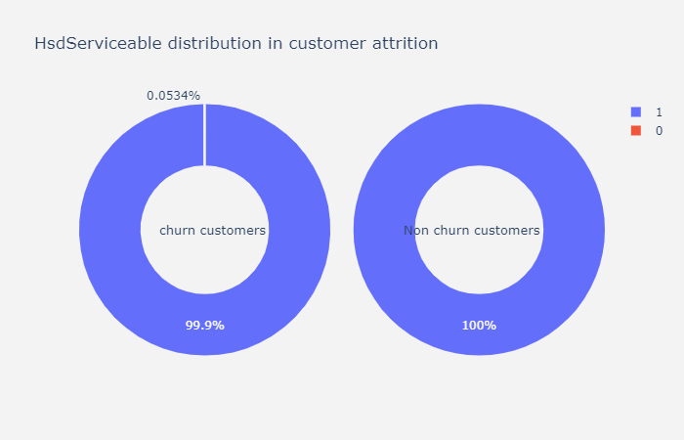
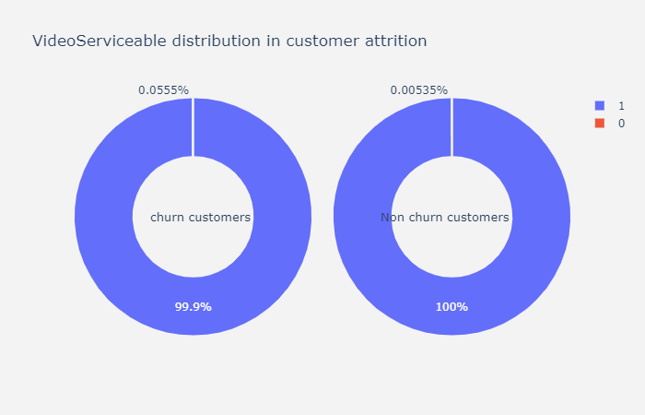
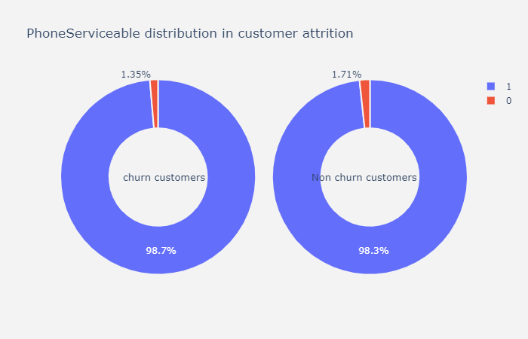

Serviceability information
Not Serviceable
Serviceable
Inference : Serviceability gives us no new information that is significant

Slide 11
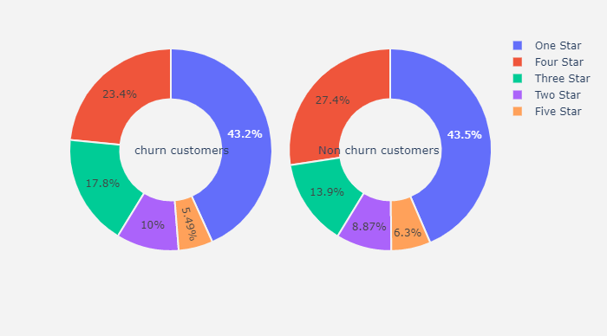

Lifetime value
NOTE - We don’t consider customers with values – Zero Rate, Bulk or Business (since they represent a very small percentage ~2% of the population
CS – Customer Status (0 – Disconnect, 1 – Active
LTV – Lifetime Value (from 1 – 5)
Inference : LifeTimeValue gives us no new information that is significant. Perhaps , there is a larger representation of lower order lifetime value customers who have left. We confirm this with a correlation check

Slide 12
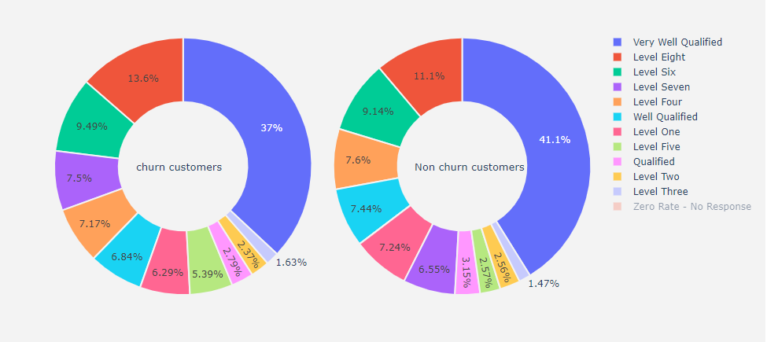
Subscriber-wise score
Inference : This gives us no new information that is significant. Representation seems to be similarly distributed

Slide 13
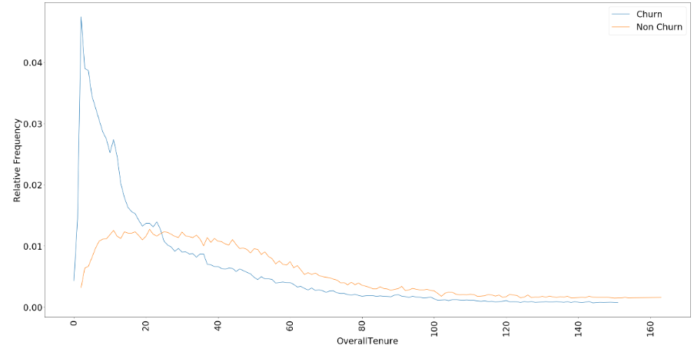
Overall Tenure
NOTE – Range for Tenure = (0,810) with a mean of 46. Therefore, we only consider customers with tenure upto 160 months for the following plot
Inference : We can see a sharp increase in percentage of customer attrition in the first 15 months

Slide 14
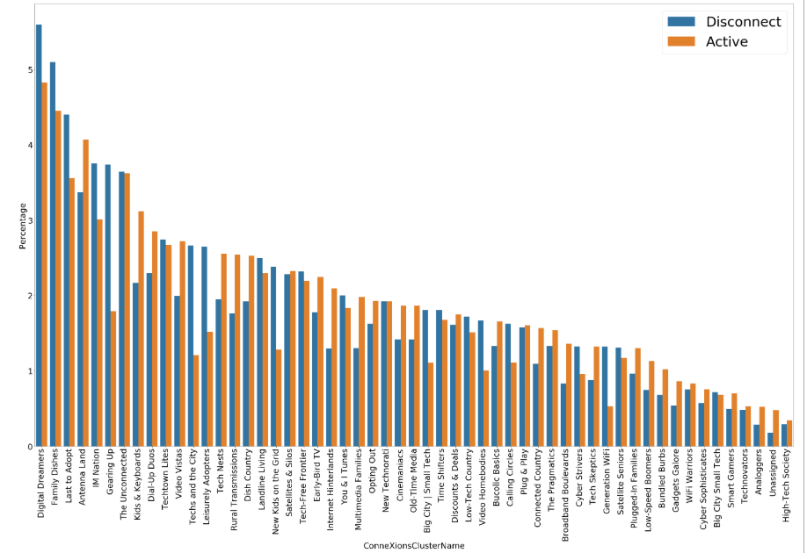
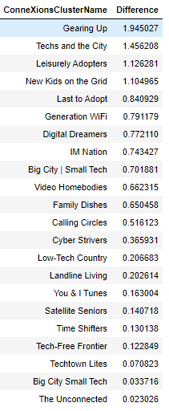
Overall Tenure by ConneXion Cluster
Inference : Granted, this chart does not make such sense on its own, we also observe the clusters in which churn rates are high (with %difference shown)

Slide 15
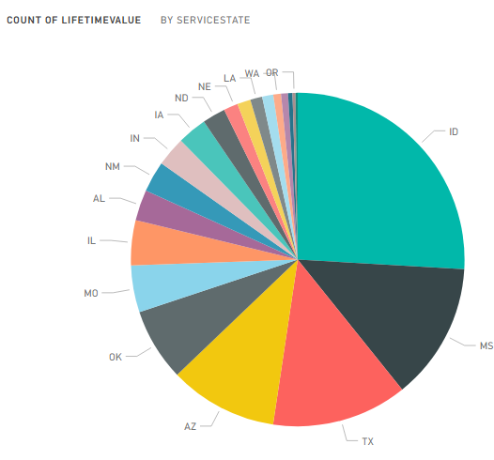
Geographical information - Statewise

Slide 16
Product
Contains product information that a customer has subscribed to/owns.

Slide 17
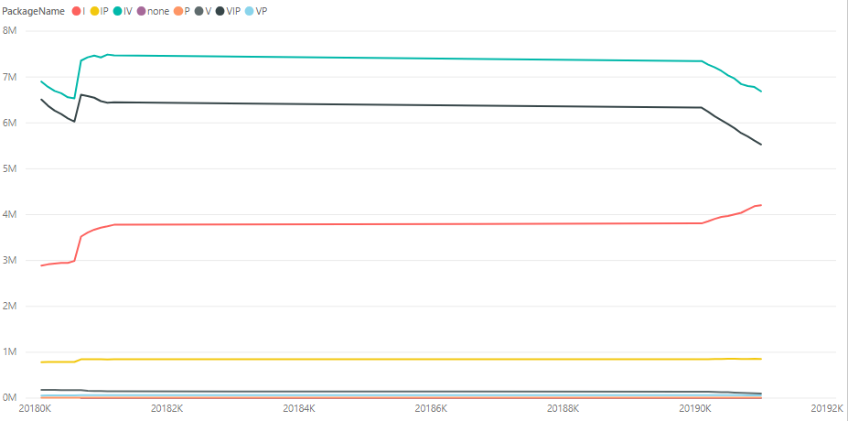
Count of customers by product type over time
Inference : There seems to be a decreasing trend in video services ,meanwhile internet subscriptions have increased as expected

Slide 18
Usage
Contains information on product usage by the customer –
Amount of internet usage : Upload, Download, Overall
Number of warnings given to customer for over-usage
Amount of over-usage of data
Forced upgrade information

Slide 19
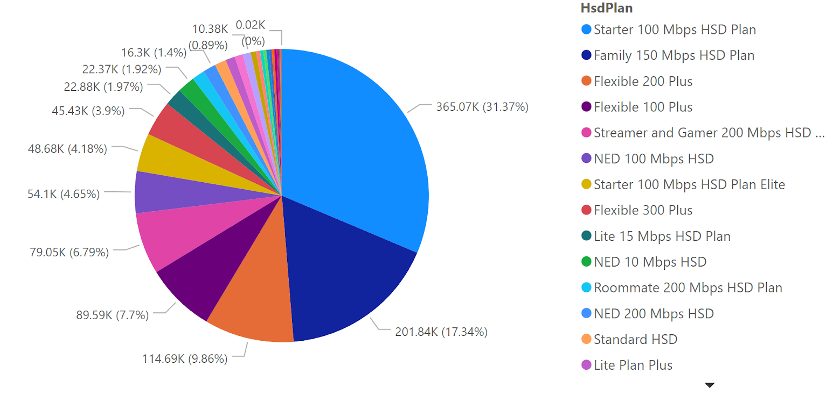
Representation of customers by plan type

Slide 20
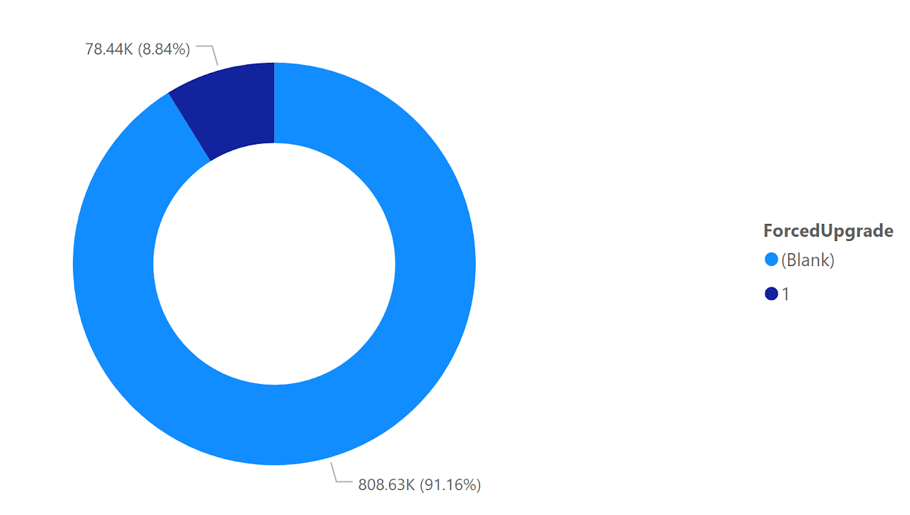
Representation of forced upgrade
No
Yes

Slide 21
Orders
Contains information on orders placed by customer
Addition of services
Removal of services
Change of services
General service

Slide 22
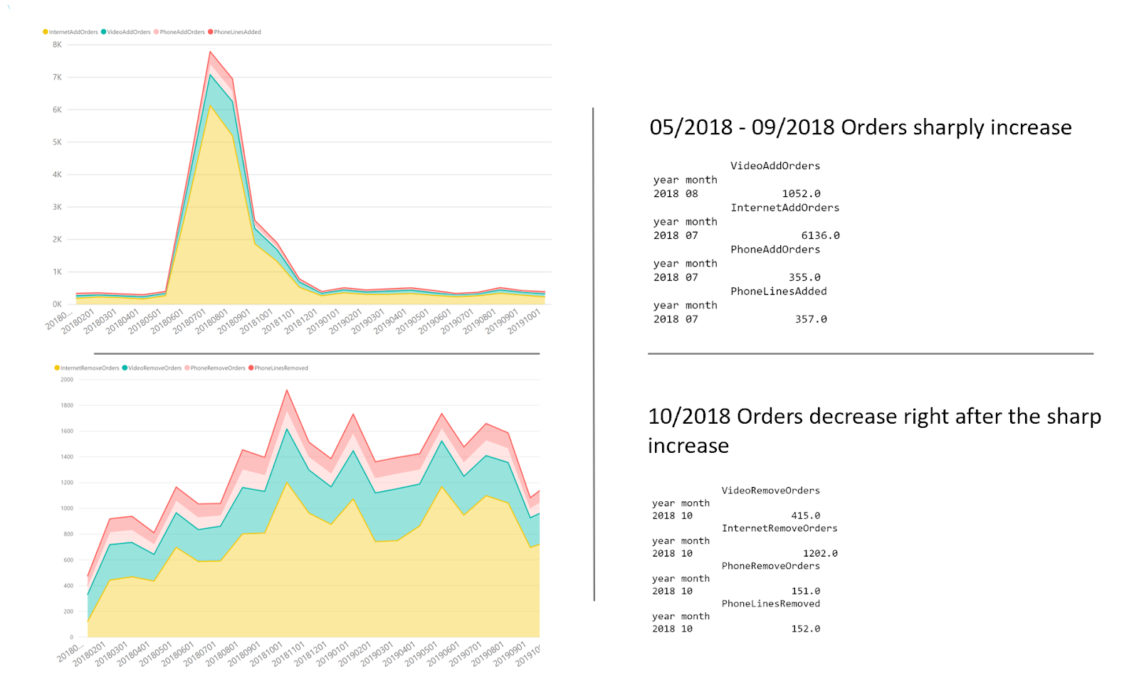

Slide 23
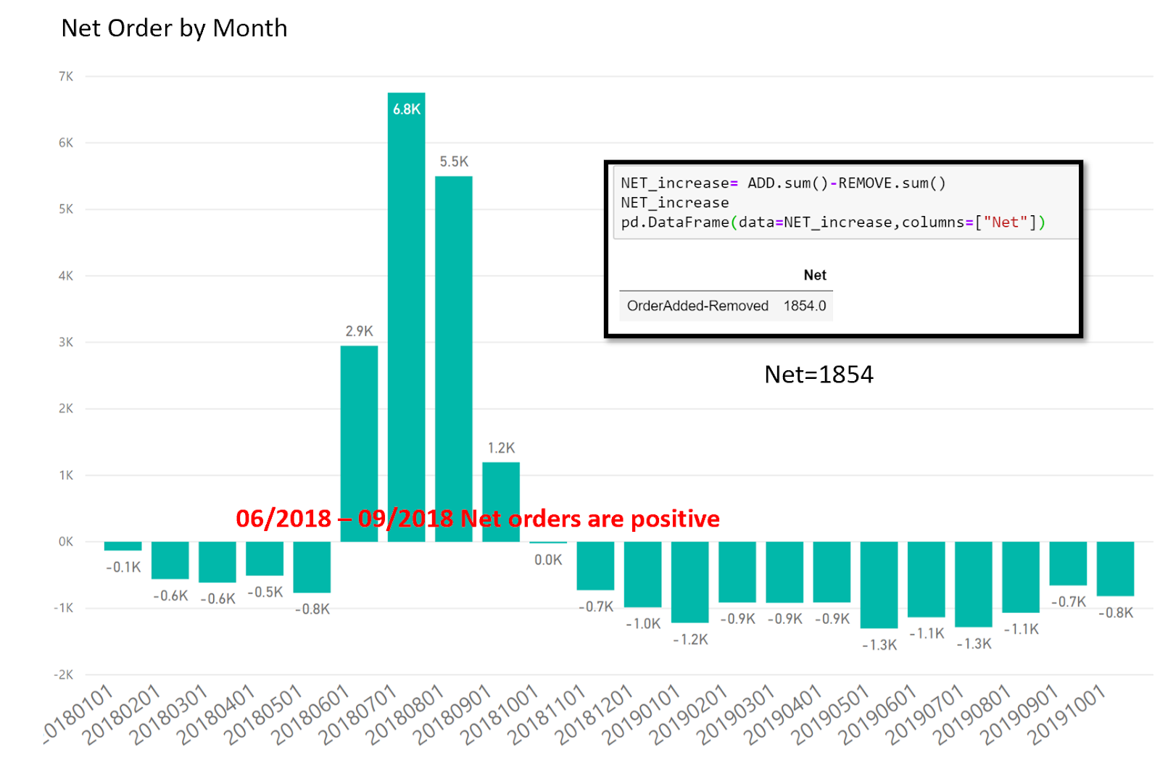

Slide 24
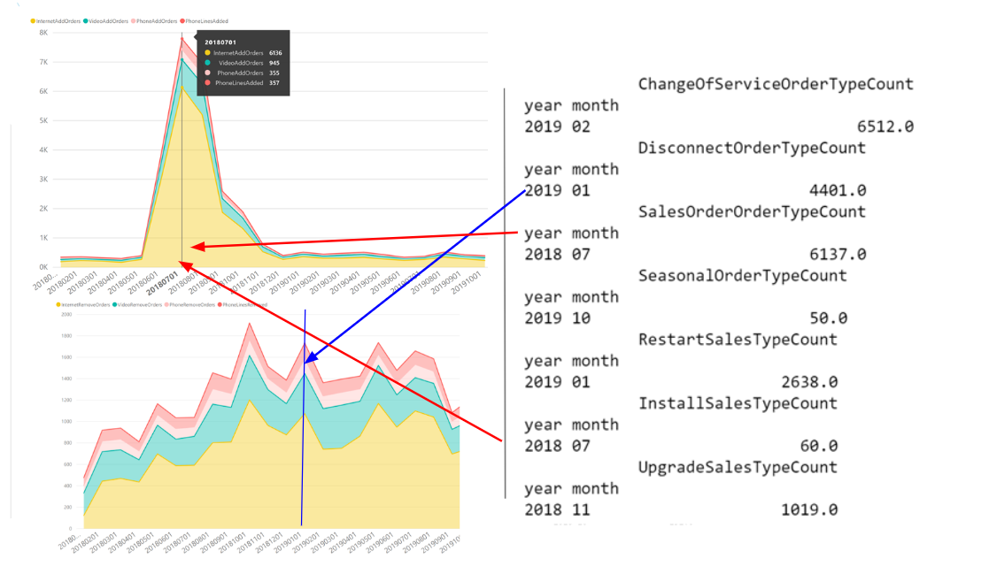

Slide 25
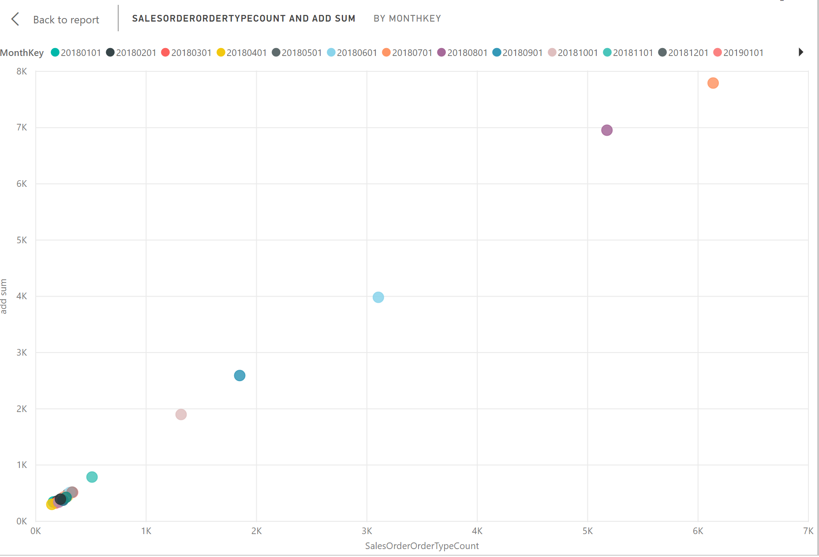
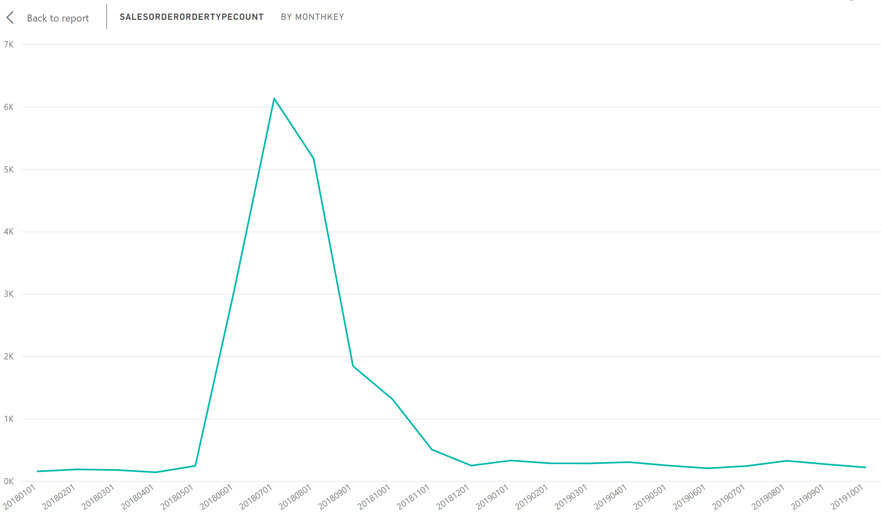
Sum of Sales Order vs. Product Added Order through time

Slide 26
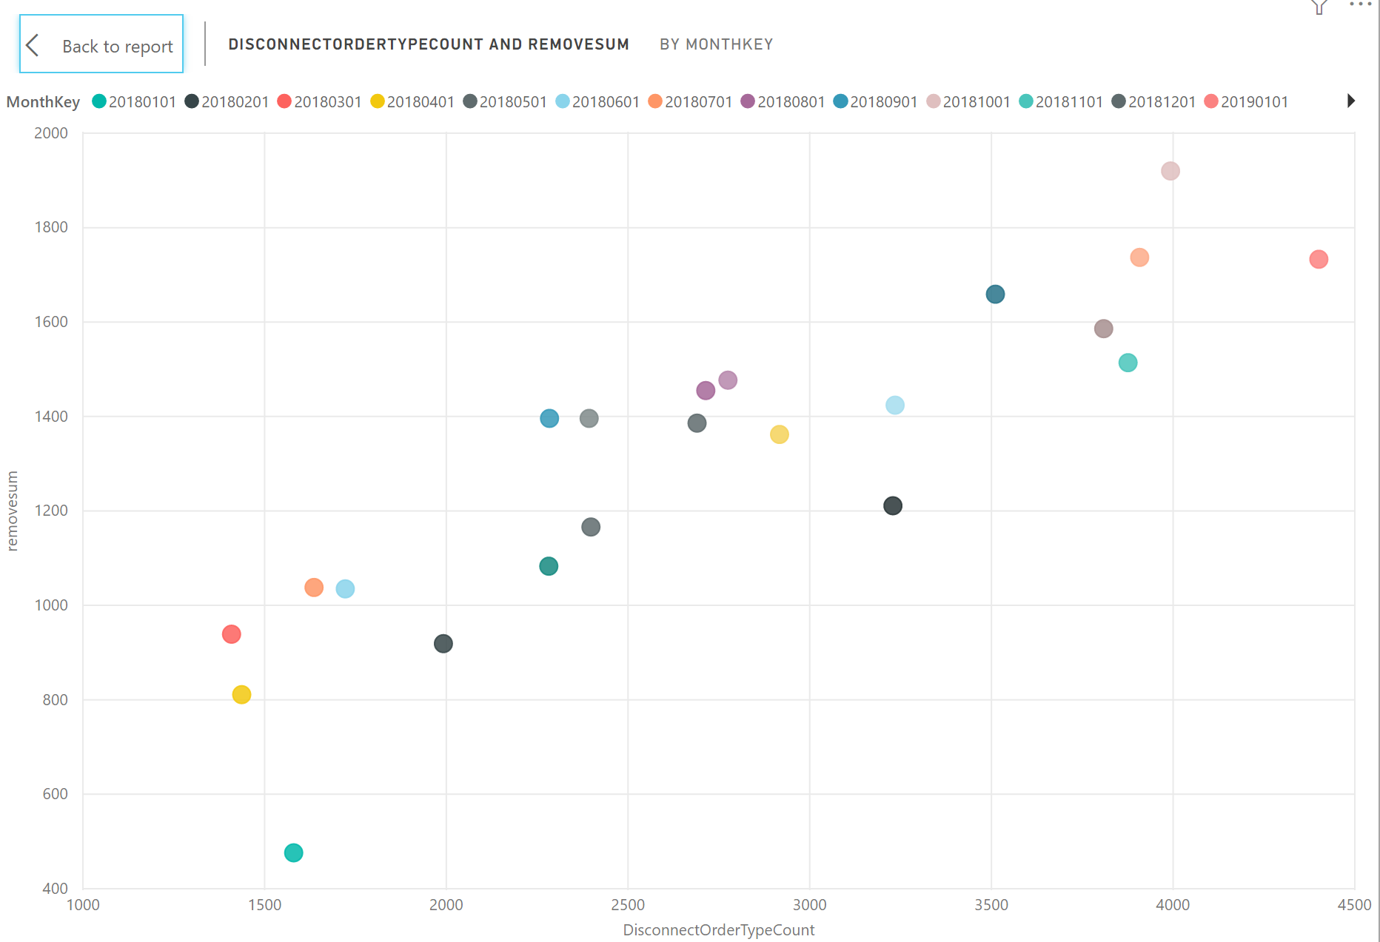
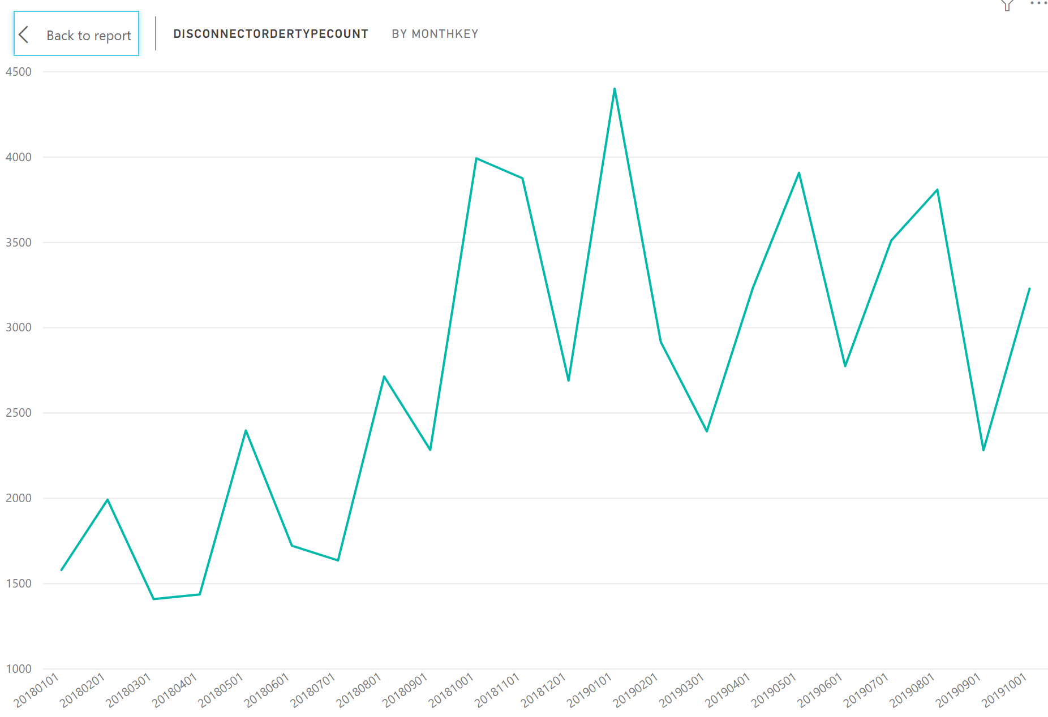
Sum of Disconnect Order vs. Product Removal Order through time
Sum of Disconnect Order Type thorough time
Notes:
(Besides, let’s see this graph, I do notice that the pattern of disconnect order type is similar to the removal order, which pretty makes sense) though I didn’t attach the graph

Slide 27
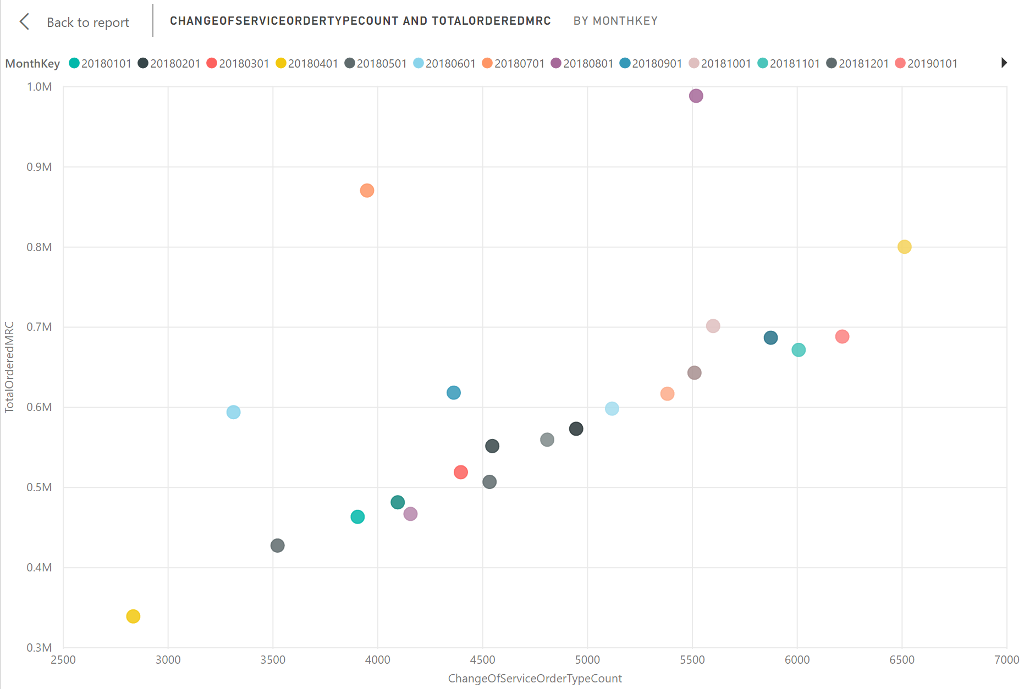
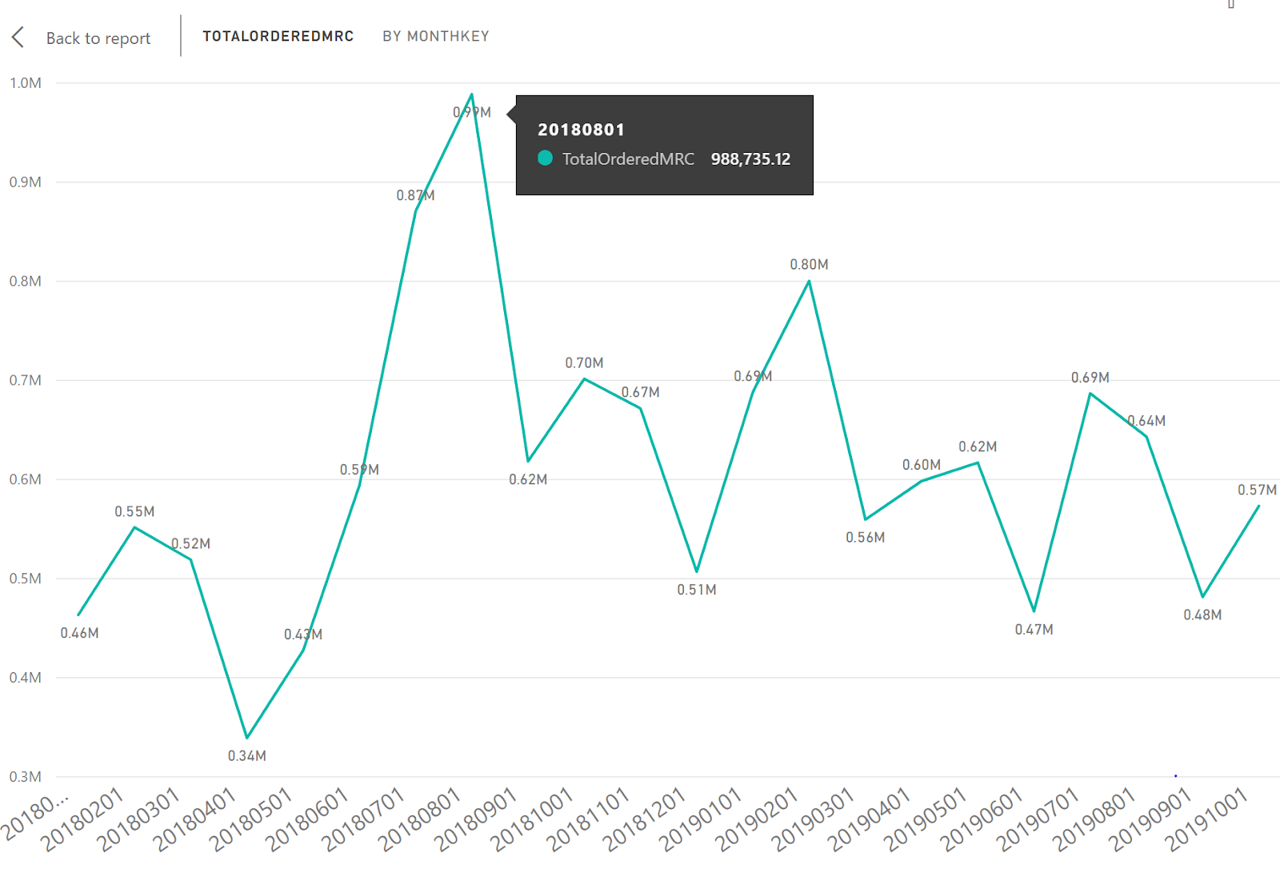
Total Ordered MRC vs. the change of the service through time
Total Ordered MRC thorough time
Notes:
It is the scatter plot which shows the relationship between the

Slide 28
Key Findings
Customer attrition rates are high during the first 2-3 years of service. Possible causes –
Dissatisfaction with customer service during installation
Hidden charges that irked the customer
Competitors offering to buy out existing contract to switch to their network
Customer attrition rates are high among the younger groups (defined by ConneXion clusters). Possible causes –
Not satisfied with the internet quality – Require higher bandwidth perhaps

Slide 29
Key Findings
Decrease in overall Video and Phone service . Possible causes-
Rise in popularity of streaming services : Netflix, Amazon Prime etc.
Reduction in popularity of phone services

Slide 30
Next Steps
Combine datasets to get a more coherent analysis of the information
Train a model to predict customer churn
Final Report

Slide 31
Thank you!
MSBA Capstone Team 1

